Slide 1

What is phonsai?

Slide 2

Developing a Mobile application is a complicated process

Slide 3
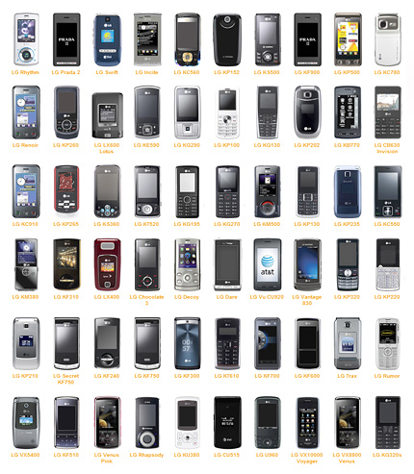
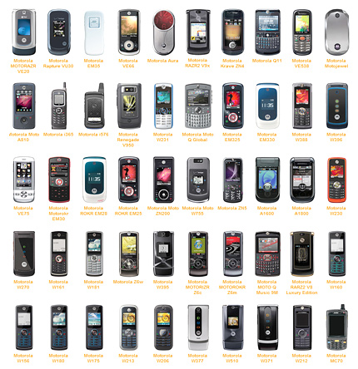
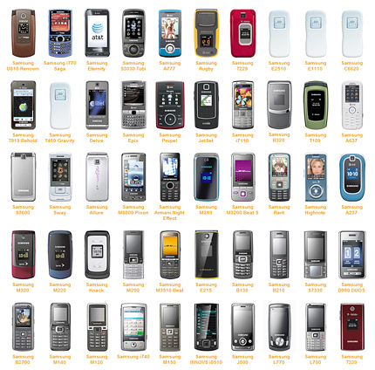
There are many brands, models, sub-models, oprating systems, screen sizes

Slide 4
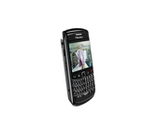
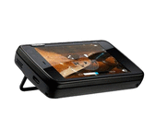
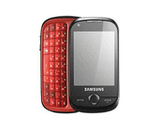
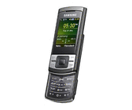
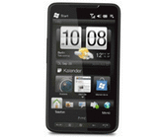
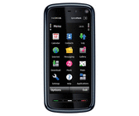
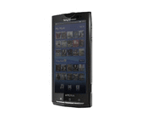
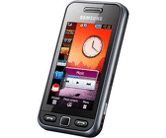
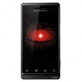

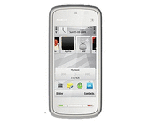
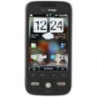
You have to consider all of these variables for your mobile apps
240 x 320 Pixel
480 x 360 Pixel
480 x 800 Pixel
640 x 480 Pixel
400 x 800 Pixel
640 x 360 Pixel
854 x 480 Pixel
240 x 400 Pixel
440 x 854 Pixel
352 x 416 Pixel
360 x 640 Pixel
320 x 480 Pixel

Slide 5









and create different versions for these cross platforms

Slide 6
That makes mobile application development complicated, expensive and time consuming

Slide 7















Phonsai is created to find a solution for this complex process
and make your mobile applications
run on cross patforms

Slide 8
With phonsai you can Create and Send mobile application and also get delivery Reports
CREATE
SEND
REPORT

Slide 9
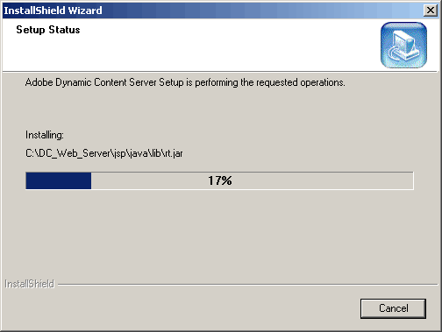
Phonsai is web based application. You do not need to install anything on your computer

Slide 10

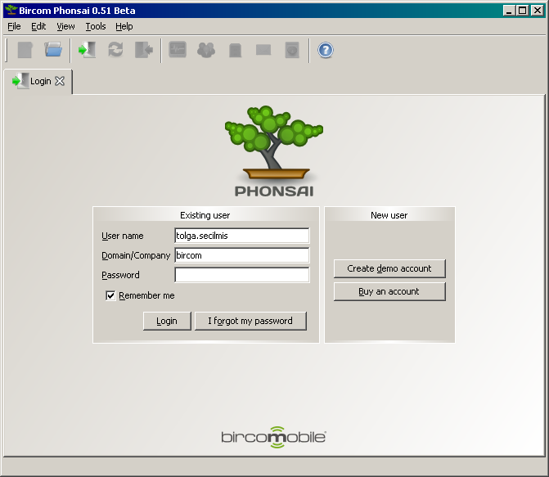
You can reach Phonsai via your web browser with your username and password.
www.phonsai.com
Denemedenemedssssss

Slide 11
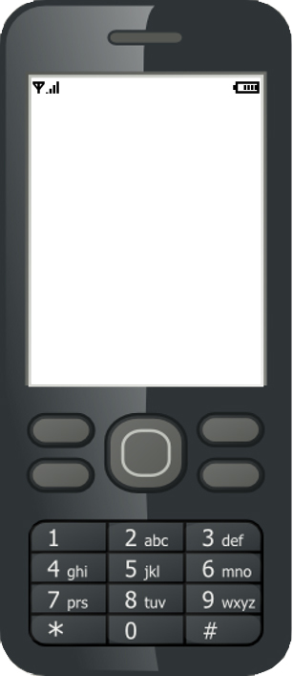





Creating Mobile App is easy
Copy and paste your text
Your images
Text
Images
Links
Phone call
Web / Wap
Links
And phone
call links

Slide 12
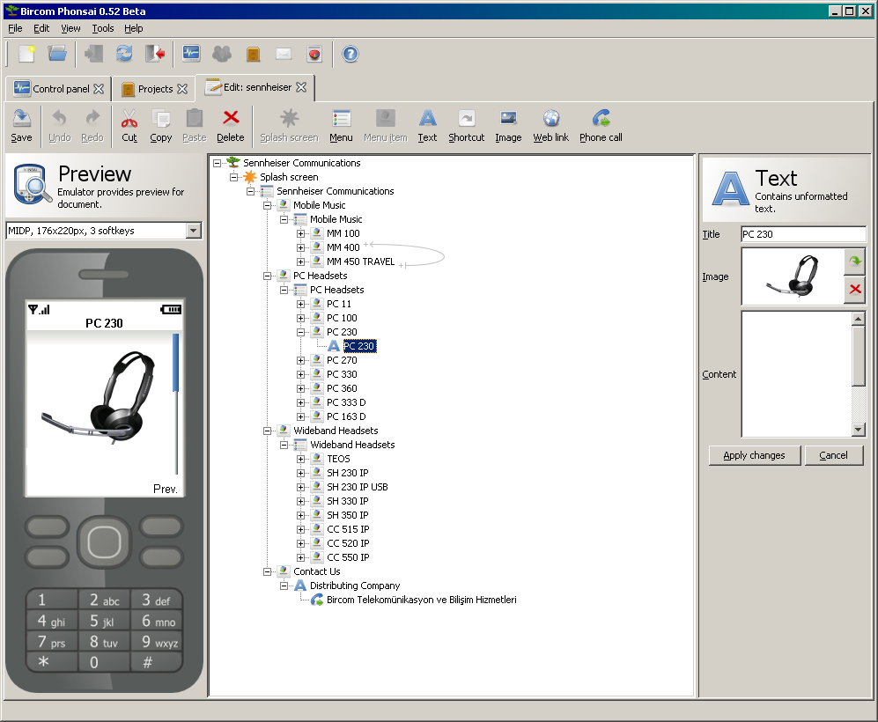
Development platform is designed for an avarage PC user to create mobile application
All you need to do is imagine your structure and start creating your application
You will see your application develop in emulator screen as you enter your content
Wired or wireless
Availability
Wired or wireless
Availability

Slide 13
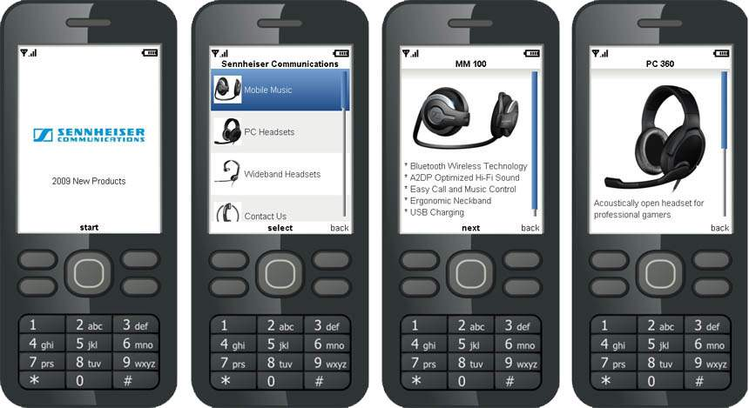
You can create your company mobile application, product brochure,

Slide 14
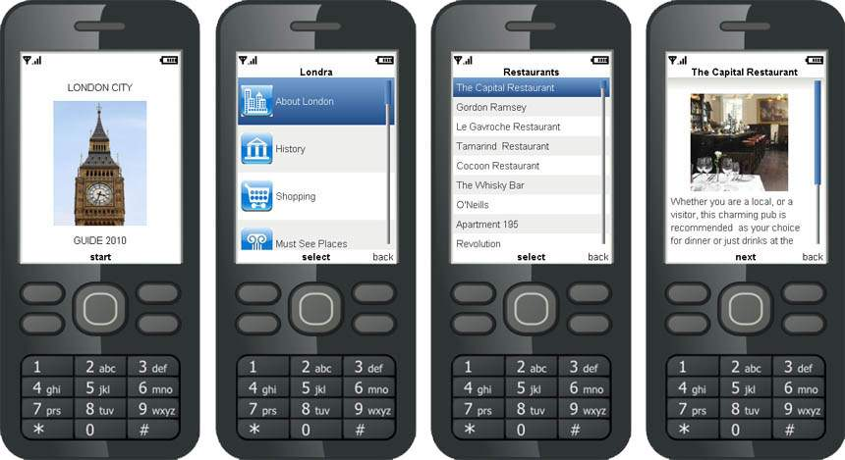
City Guides

Slide 15
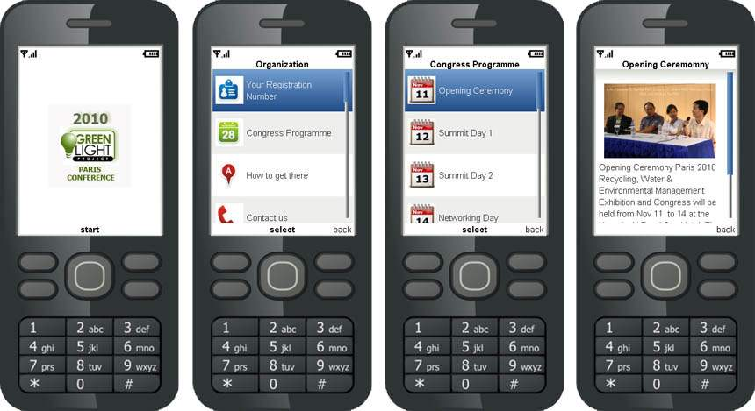
Organization and event invitations

Slide 16
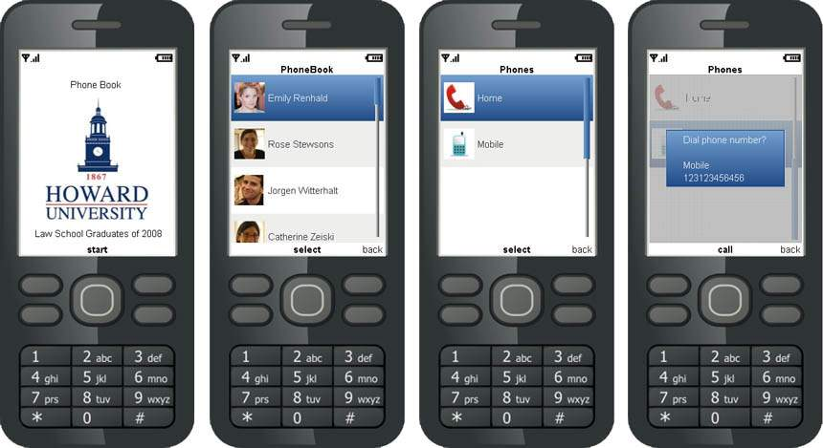
Customized Phonebooks

Slide 17
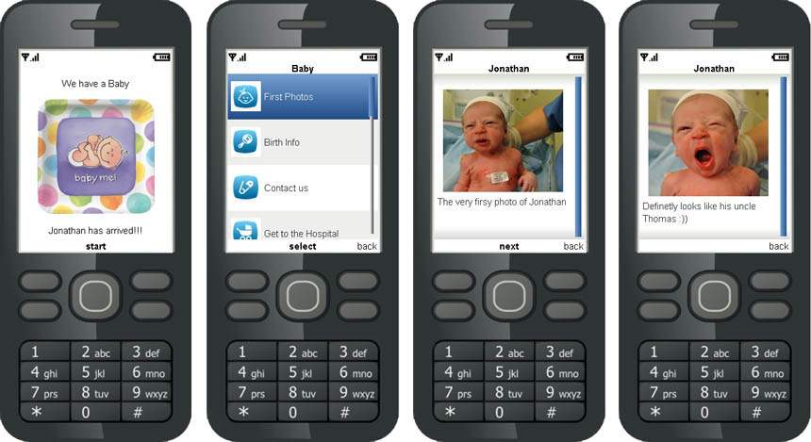
Smart Photo Albums

Slide 18
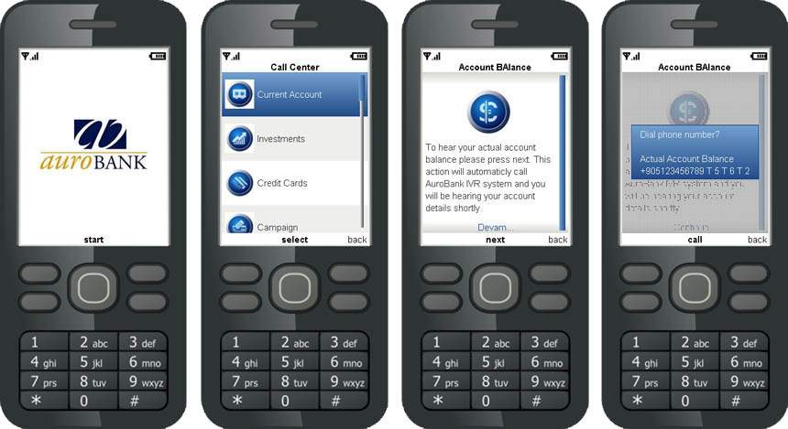
Call Center and IVR Mapping

Slide 19
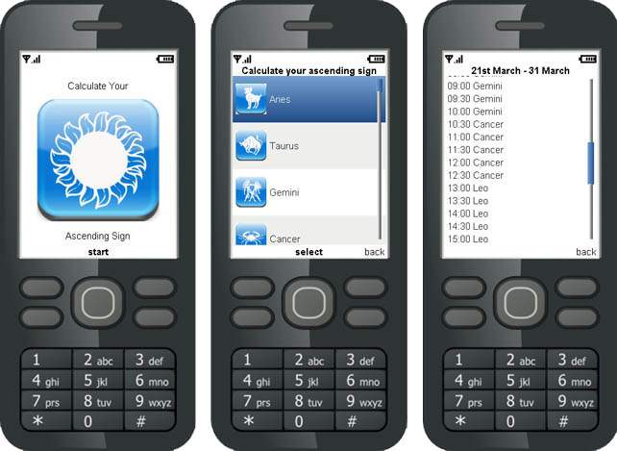
Hobby Applications

Slide 20
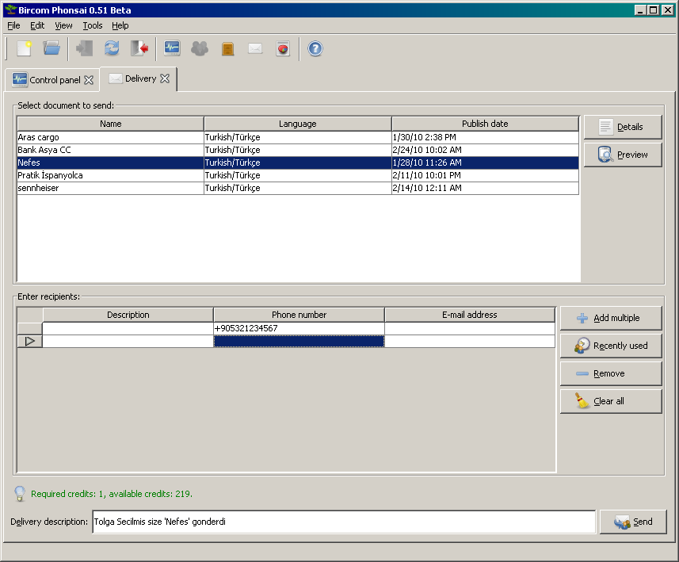
Once you finished creating your application write the phone number or numbers of the people you want to send
Your application will be on their phone in a flash

Slide 21
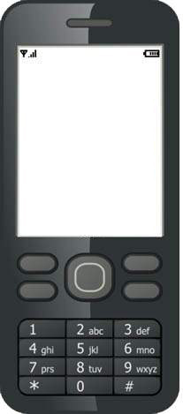
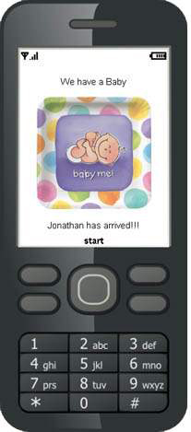
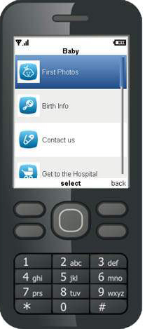
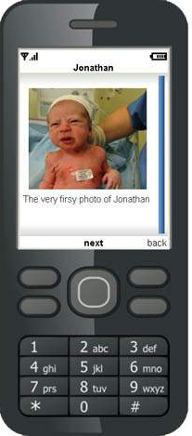
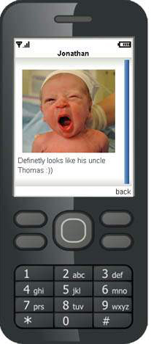
Your target audience will receive a wappush message and download the application
Phonsai kullanarak
size 1 wapush
mesajı gönderildi
Kabul etmek
istiyormusunuz?
Evet

Slide 22
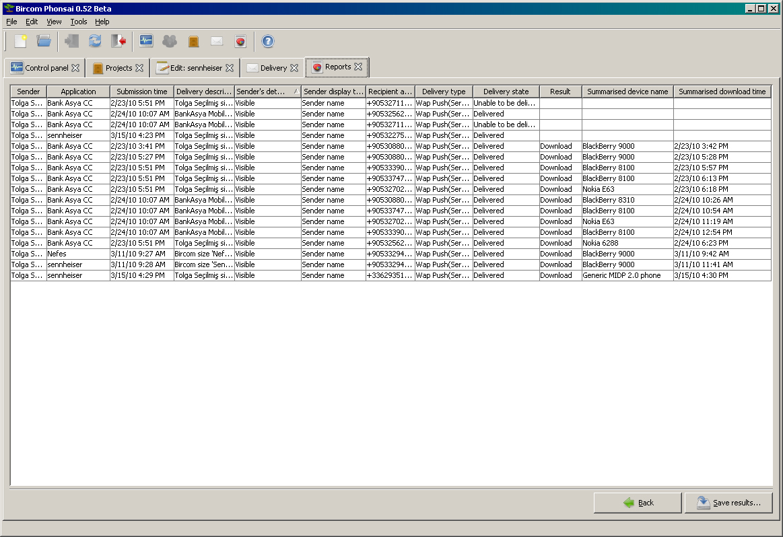
From report tab you can see who downloaded your application and get more details

Slide 23
www.bircom.com
tolgas@bircom.com

